Slide 1
Digital Portfolio
STUDENT NAME: L.Joyce
REGISTER NO AND NMID: 24132071802522001
BBAC030938D78E3B53D4F9C3EE2BE50E
DEPARTMENT: bsc.computer science
COLLEGE: ks.raja arts and science college for womens /Affiliated to Annamalai University

Slide 2
PROJECT TITLE
Personal portfolio

Slide 3


AGENDA
Problem Statement
Project Overview
End Users
Tools and Technologies
Portfolio design and Layout
Features and Functionality
Results and Screenshots
Conclusion
Github Link
3/21/2024 Annual Review

Slide 4

PROBLEM STATEMENT
In today’s competitive world a simple resume is not enough a digital portfolio is a powerful tool that conveys your creativity and best work to the world.

Slide 5

PROJECT OVERVIEW
This project aims to create a personal digital portfolio to showcase my professional achiervement skills and project

Slide 6

WHO ARE THE END USERS?
Recruiters and Hiring Managers – who assess the students skills, experience, and creativity before interviews or job offers.
Clients or Potential Employers – who evaluate the portfolio to decide whether to hire the student for freelance or professional work.

Slide 7

TOOLS AND TECHNIQUES
Visual Studio Code – as the primary code editor for development and project hosting platform (GitHub pages)
Css-for styling and text
HTML – for structuring the content and layout of the web pages
Styling and colors and sections etc,,,

Slide 8
POTFOLIO DESIGN AND LAYOUT
Section Layout – The page is divided into logical sections: Home, About, Projects, and Contact, making navigation simple and intuitive.
Navigation Bar – A fixed top navigation bar allows users to jump between sections easily, improving usability.
Use of Semantic HTML Tags – Elements like <header>, <section>, <nav>, and <footer> help structure the content meaningfully and improve accessibility.
8

Slide 9
FEATURES AND FUNCTIONALITY
Section-Based Layout – Includes Home, About, Projects, and Contact sections for easy navigation.
Navigation Bar – Fixed top menu with anchor links for smooth scrolling between sections.
Clickable Navigation Links – Allow users to jump to specific sections instantly.

Slide 10
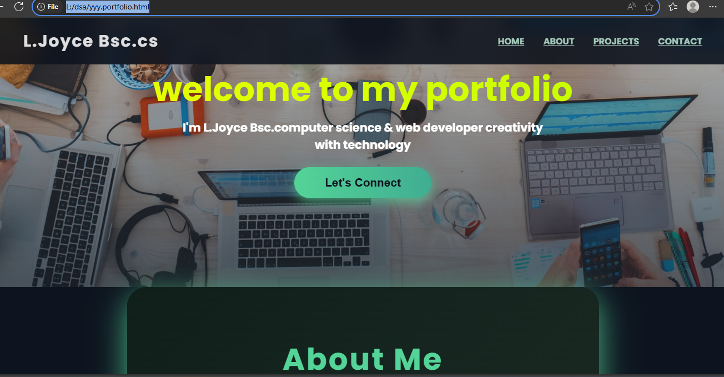

RESULTS AND SCREENSHOTS
3/21/2024 Annual Review
10

Slide 11
CONCLUSION
In conclusion, this portfolio project helped me showcase my skills in web development using HTML. I was able to create a clean and responsive layout that highlights my academic background, personal projects, and contact information. Through this process, I learned how to organize content effectively, apply design techniques, and present myself. Overall, it was a valuable learning experience and an important step in building my digital identity
11

